Slide 1



Network Analysis Methods for studying microbial communities : A mini review
An in-depth peer review of the Network Analysis Methods by :
Daniel Agyapong
da2343@nau.edu
1st year PhD student
Dr. Toby Hocking
Toby.Hocking@nau.edu
Machine Learning Director

Slide 2
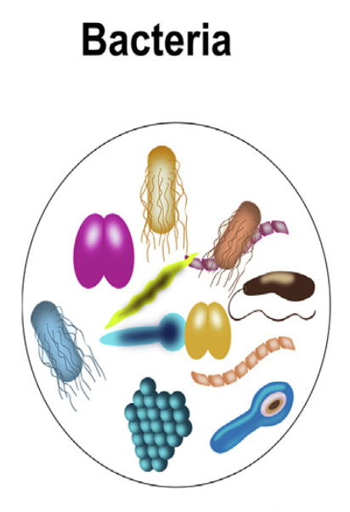
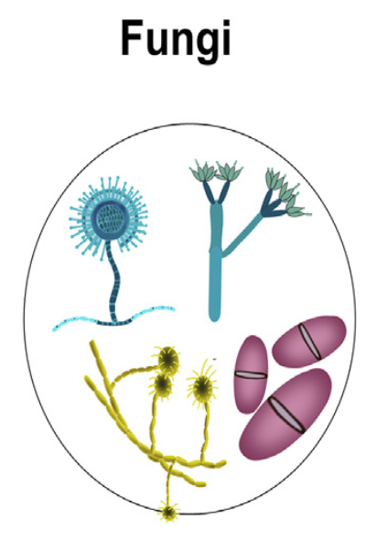
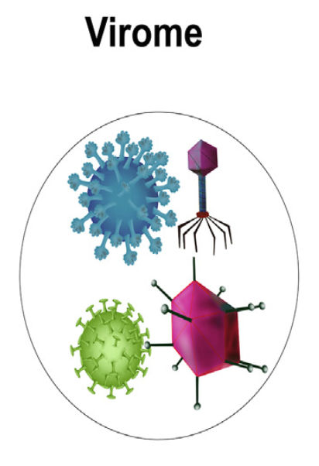
BACKGROUND
Microbial communities consist of micro-organisms such as bacteria, virus and fungi.
Micro-organisms have built robust ecosystems in various environments such as soil, sea water and various human organs.
Extensive research has been done on interactions between host and its microbiome.
These studies have revealed several cases of complex dynamics including trans-kingdom interactions between these micro-organisms and their effects on the host.
The term “complex system” represents a system whose collective behavior is difficult to determine from knowing the components of the system.

Slide 3

BACKGROUND
The microbes that live in humans
Ref: https://www.youtube.com/watch?v=c_ZRZkU-FEw

Slide 4
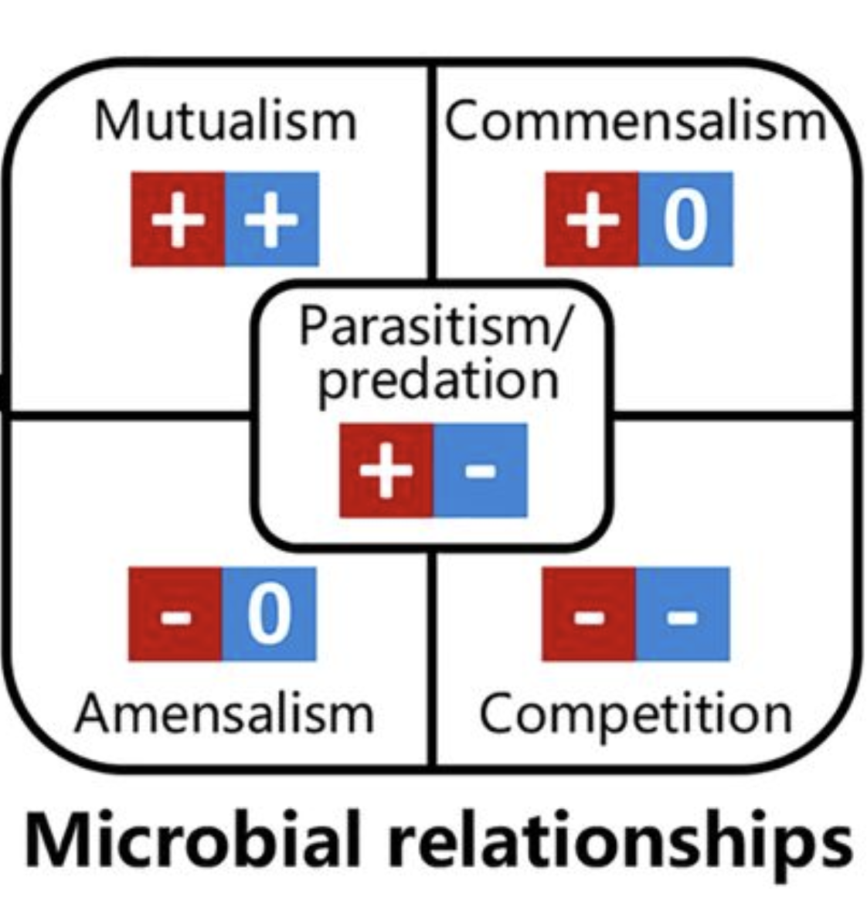
BACKGROUND
Microorganisms form complex ecological interactions which are :
win-win relationships such as mutual cross-feeding and cooperation interactions
win-lose relationships such as predator-prey and host-parasite interactions
lose-lose relationship such as competitive exclusion interactions
win-draw relationship which one organism benefits without harming the other like commensalism.
lose-draw relationship which one organism is harmed but the other is unaffected like amensalism.
These relationships are very essential in the assembly of microbial community.
Reconstructing microbial ecological networks to represent these interactions would help to understand the complex behaviors in microbial communities.

Slide 5
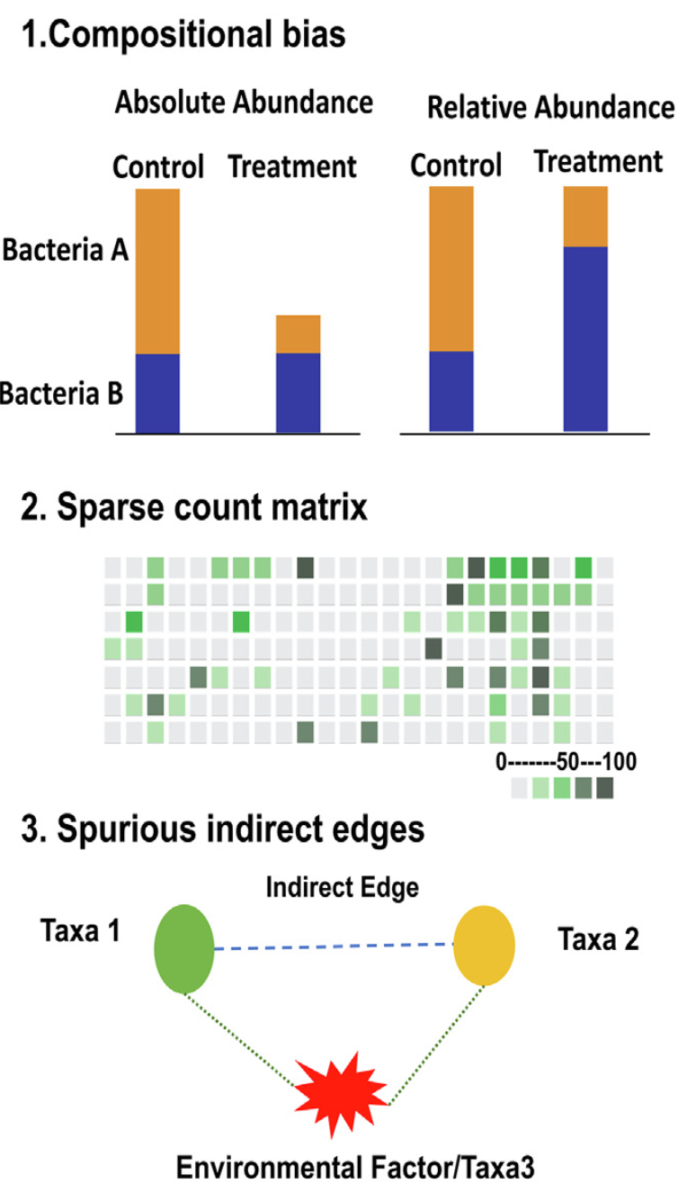
METHODOLOGY
Network-based analytical approaches have helped in the study of systems with complex microbial interactions.
The literature gives an overview of simple correlation and complex conditional dependence-based methods used to infer intra-kingdom interactions.
There are also various network-based methods for trans-kingdom analysis.
For simplicity of usage, there are also many packages in various programming languages like R and Python that replicate the functionality of these methods.
Decoding complex microbial co-occurrence relationships is associated with three main challenges.

Slide 6
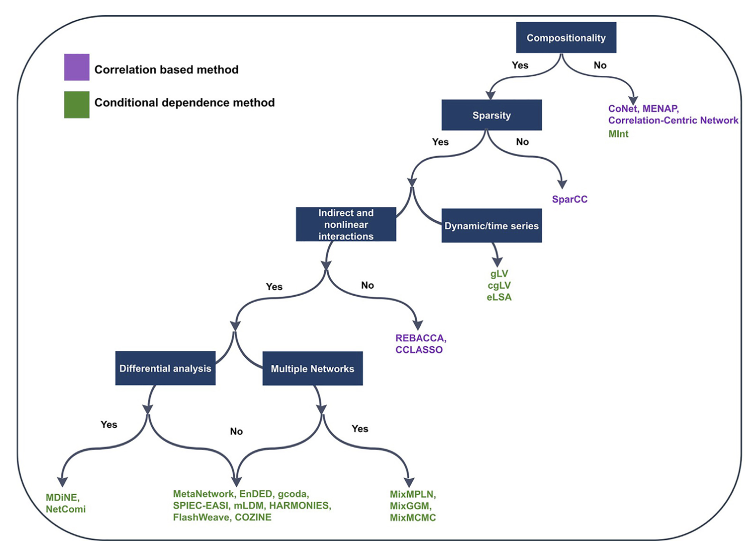
WORKFLOW INDICATING THE SUITABLE NETWORK APPROACHES DEPENDING ON DIFFERENT CHALLENGES

Slide 7
Correlation Based Methods
Method | SparCC (2012) | CCLasso (2015) | REBACCA(2015) | CoNet (2016) | Meta-Network (2019)
Link | https://rdrr.io/github/zdk123/SpiecEasi/man/sparcc.html | https://github.com/huayingfang/CCLasso | https://faculty.wcas.northwestern.edu/hji403/REBACCA.htm | https://github.com/ramellose/CoNetinR | https://github.com/guido-s/netmeta
Principle | Pearson correlations via Bayesian framework | Latent variable model with l1- norm shrinkage method | Linear system using pairwise log ratios | Bray and Curtis, Kullback–Leibler dissimilarity measures, Pearson and Spearman correlation, and mutual information. | Hybrid method with Pearson Correlation and graph-based method FS-Weight method to study indirect relationships
Link to Data

Slide 8
Conditional Dependence Methods
Method | gCoda (2017) | NetComi (2020) | SPIEC-EASI (2015) | MDiNE (2019) | MixMPLN (2019)
Link | https://github.com/huayingfang/gCoda | https://github.com/stefpeschel/NetCoMi | https://github.com/zdk123/SpiecEasi | https://github.com/kevinmcgregor/mdine | https://github.com/sahatava/MixMPLN
Principle | Logistic normal distribution Majorization-Minimization algorithm | Integrates extensive methods that take into account the special characteristics of amplicon data. | Graphical models using selecting neighborhoods or inverse covariance | Bray and Curtis, Kullback–Leibler dissimilarity measures, Pearson and Spearman correlation, and mutual information. | Hybrid method with Pearson Cor- relation and graph-based method FS-Weight method to study indirect relationships
Link to Data |  |  | https://github.com/zdk123/SpiecEasi/tree/master/data

Slide 9
Conditional Dependence Methods
Method | Mint (2015) | mLDM (2016) | HARMONIES (2020) | COZINE (2020)
Link | https://cran.r-project.org/web/packages/MInt | https://github.com/tinglab/mLDM | https://github.com/shuangj00/HARMONIES | https://github.com/MinJinHa/COZINE
Principle | Poisson-multivariate normal hierarchical model | Lognormal-Dirichlet Multinomial hierarchical model | Zero-inflated negative binomial distribution with Dirichlet process prior | Multivariate Gaussian Hurdle model
Link to Data |  |  | https://github.com/shuangj00/HARMONIES/tree/master/data

Slide 10
SPIEC EASI
SPIEC EASI means Sparse InversE Covariance estimation for Ecological Association and Statistical Inference.
Inferring interactions among different microbial species within a community and understanding their influence on the environment is of central importance in ecology and medicine
It helps to infer graphical models microbiome relative abundance data by measuring frequency of co-occurrence
SPIEC-EASI combines data transformations developed for compositional data analysis with a graphical model inference framework that assumes the underlying ecological association network is sparse.

Slide 11
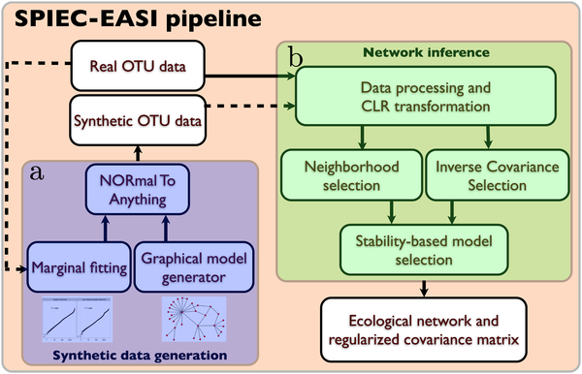
Workflow of the SPIEC-EASI pipeline
OTU – Operational Taxonomic Unit
CLR – Centered Log Ratio

Slide 12
The SpiecEasi R package
This package helps to infer graphical models for all sorts of compositional data primarily for microbiome relative abundance data (generated from 16S amplicon sequence data).
The 16S rRNA is a genetic marker unique to bacteria and archaea
The 16S rRNA amplicon sequencing technique is a microbiome analysis where different samples are analyzed at the same time using multiplexing.
The results are used to evaluate microbial diversity at genus, family, order, class, and phylum levels.
The relative occurrence of the taxonomic units at the levels of genus, family, order, class, and phylum can be compared between samples.

Slide 13
Applying SpiecEasi to American Gut data
The American Gut Project was co-founded in November 2012 and its goal was to better understand human microbiomes like which types of bacteria live where, how many of each, and how they are influenced by diet, lifestyle and disease.
They collected fecal, oral or skin swab from people in US and asked them their general health status.
They used the 16S rRNA molecule to identify bacteria living in a participant’s mixed sample.
The data that they collected are publicly available.

Slide 14
Applying SpiecEasi to American Gut data
library(phyloseq)
data('amgut2.filt.phy’)
#Runs the whole SPIEC-EASI pipeline, from data transformation,
#sparse inverse covariance estimation and model selection.
se.mb.amgut2 <- spiec.easi(amgut2.filt.phy, method='mb', lambda.min.ratio=1e-2, nlambda=20, pulsar.params=list(rep.num=50))
#Converts an adjacency matrix to an igraph object
ig2.mb <- adj2igraph(getRefit(se.mb.amgut2), vertex.attr=list(name=taxa_names(amgut2.filt.phy)))
#displays networks using advanced ggplot2 formatting
plot_network(ig2.mb, amgut2.filt.phy, type='taxa', color="Rank3")

Slide 15
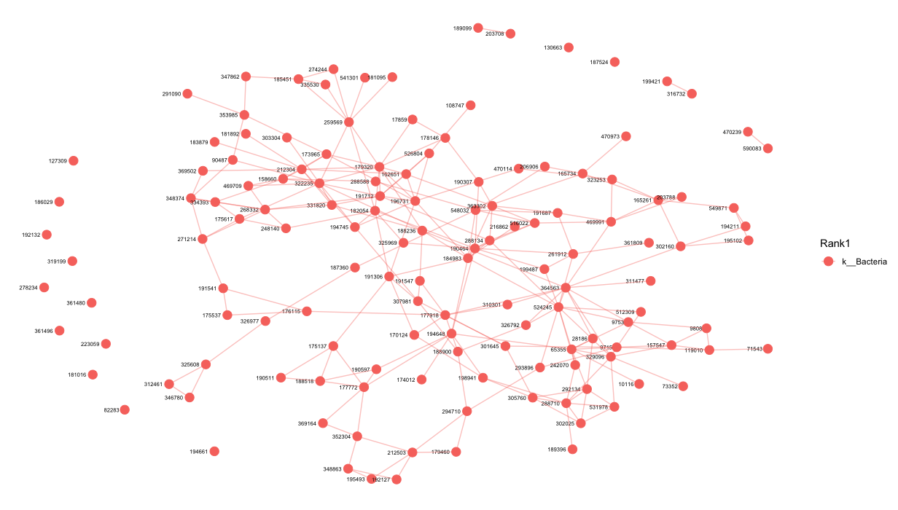
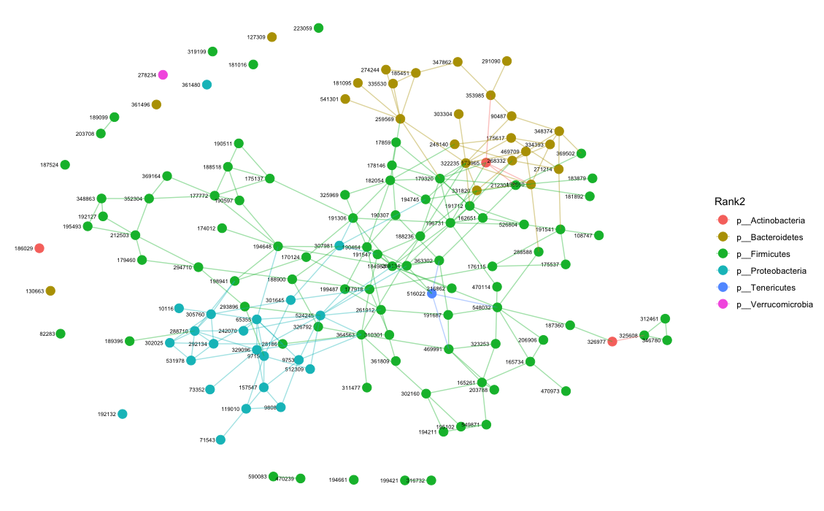
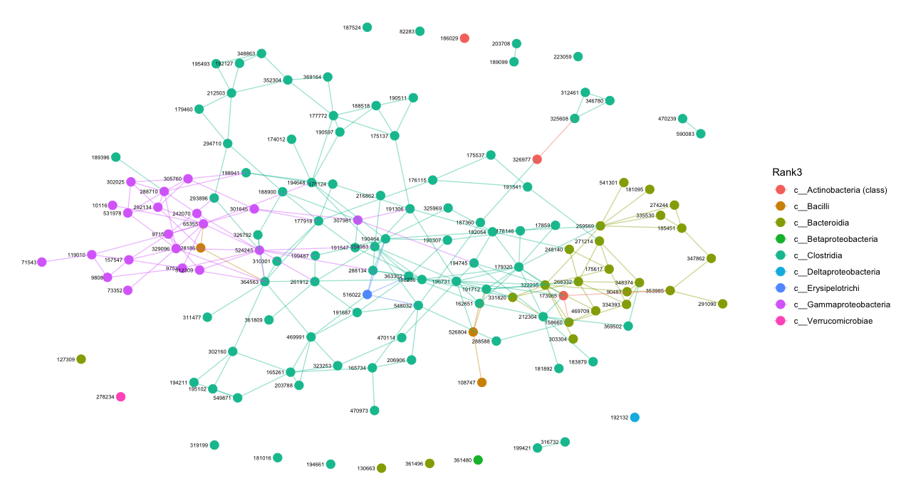
NETWORK OUTPUT

Slide 16
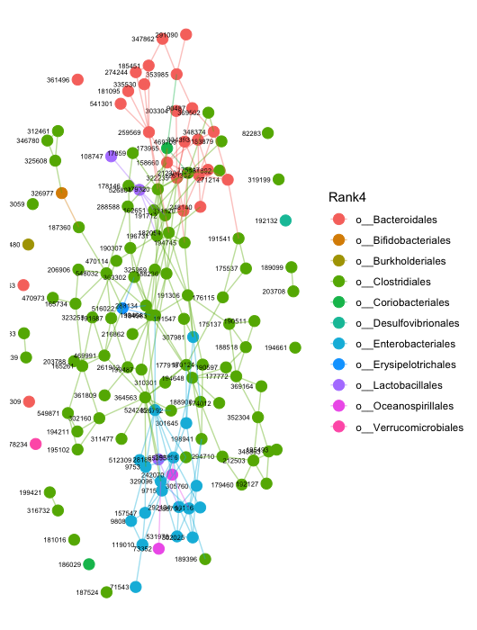
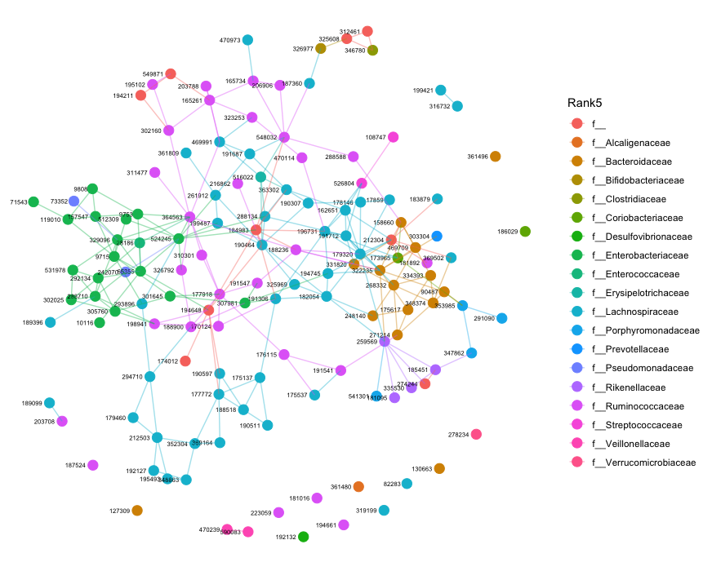
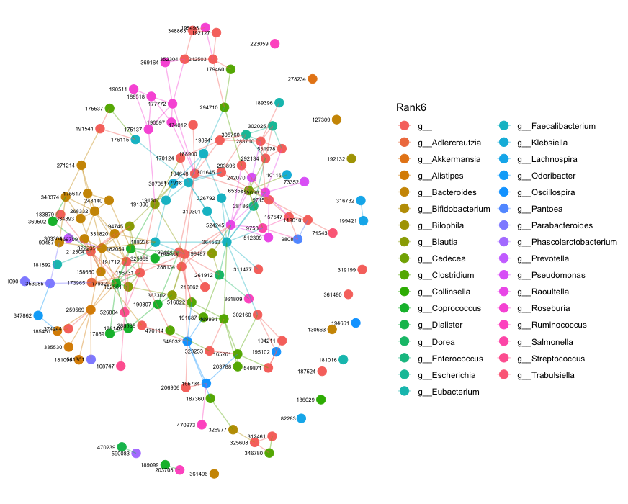
NETWORK OUTPUT

Slide 17
ANY QUESTIONS?
THANK YOU

Slide 18
References
https://www.liebertpub.com/doi/10.1089/cmb.2021.0406
https://www.youtube.com/watch?v=dCVJN_1R3c8
https://journals.plos.org/ploscompbiol/article?id=10.1371/journal.pcbi.1004226
https://doi.org/10.1128/mSystems.00124-19
https://www.thoughtco.com/commensalism-definition-and-examples-4114713
https://www.sciencedaily.com/releases/2018/05/180515092931.htm

